Slide 1
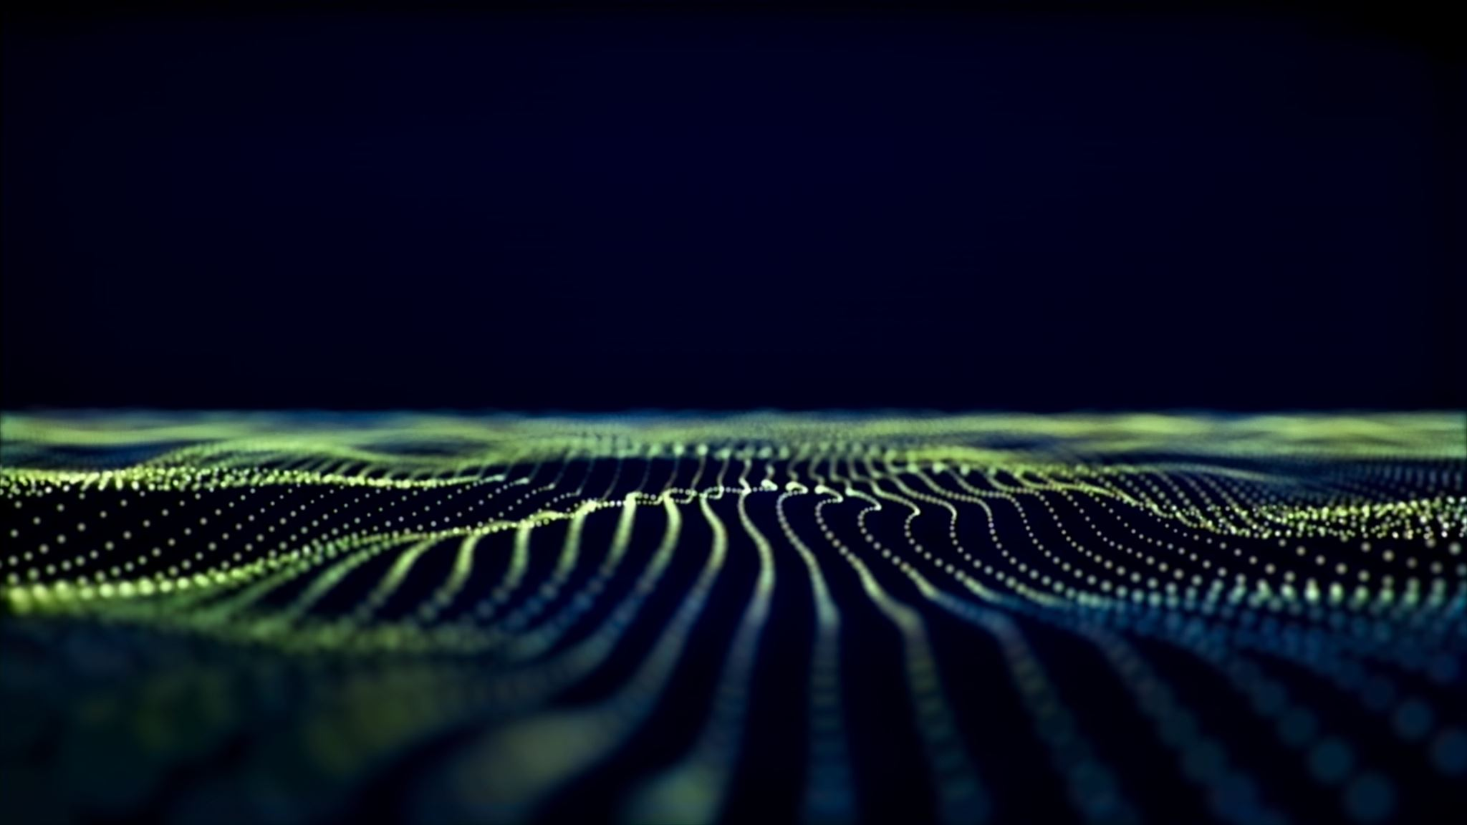
Cool Animations
Raed Diab

Slide 2
Outline
The Big Picture
Mirrors

Slide 3

Outline
The Big Picture
Output Mirror
Input Mirror
Optical Cavities

Slide 4

Outline
The Big Picture
Output Mirror
Input Mirror
Optical Cavities
Alignment

Slide 5
Outline
The Big Picture
Output Mirror
Input Mirror
Optical Cavities
Alignment
OR
Mode Matching

Slide 6
Pros & Cons of
Pros
Cons
Notes:
pros and cons of WFS ... title
add one more pro
using exisiting PM sidebands

Slide 7
Pros & Cons
Pros
Cons
Pros
Cons
Notes:
Each QPD has 4 RF channels - 8 RF channels per cavity
centering loops required

Slide 8
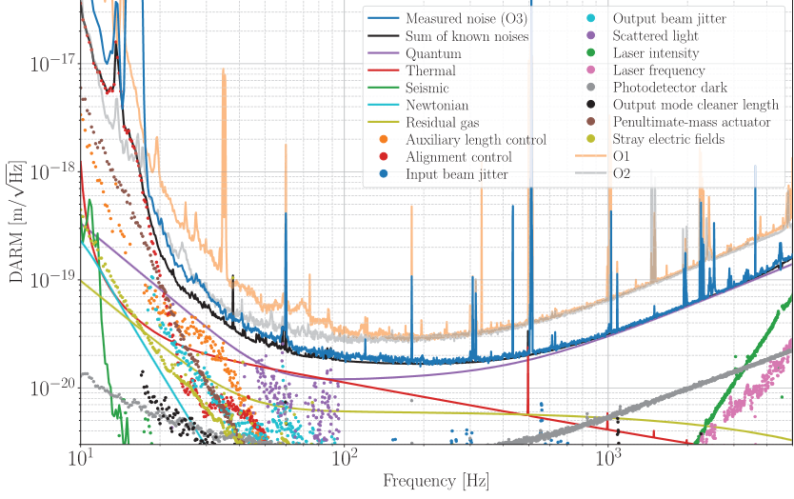
Noises
What is it that limits the performance of the detector?
Notes:
Noises = Strain Sensitivity

Slide 9

Strain sensitivity: minimum strain of GW that we can detect
Multiply by arm length to minimum arm distortion

Slide 10
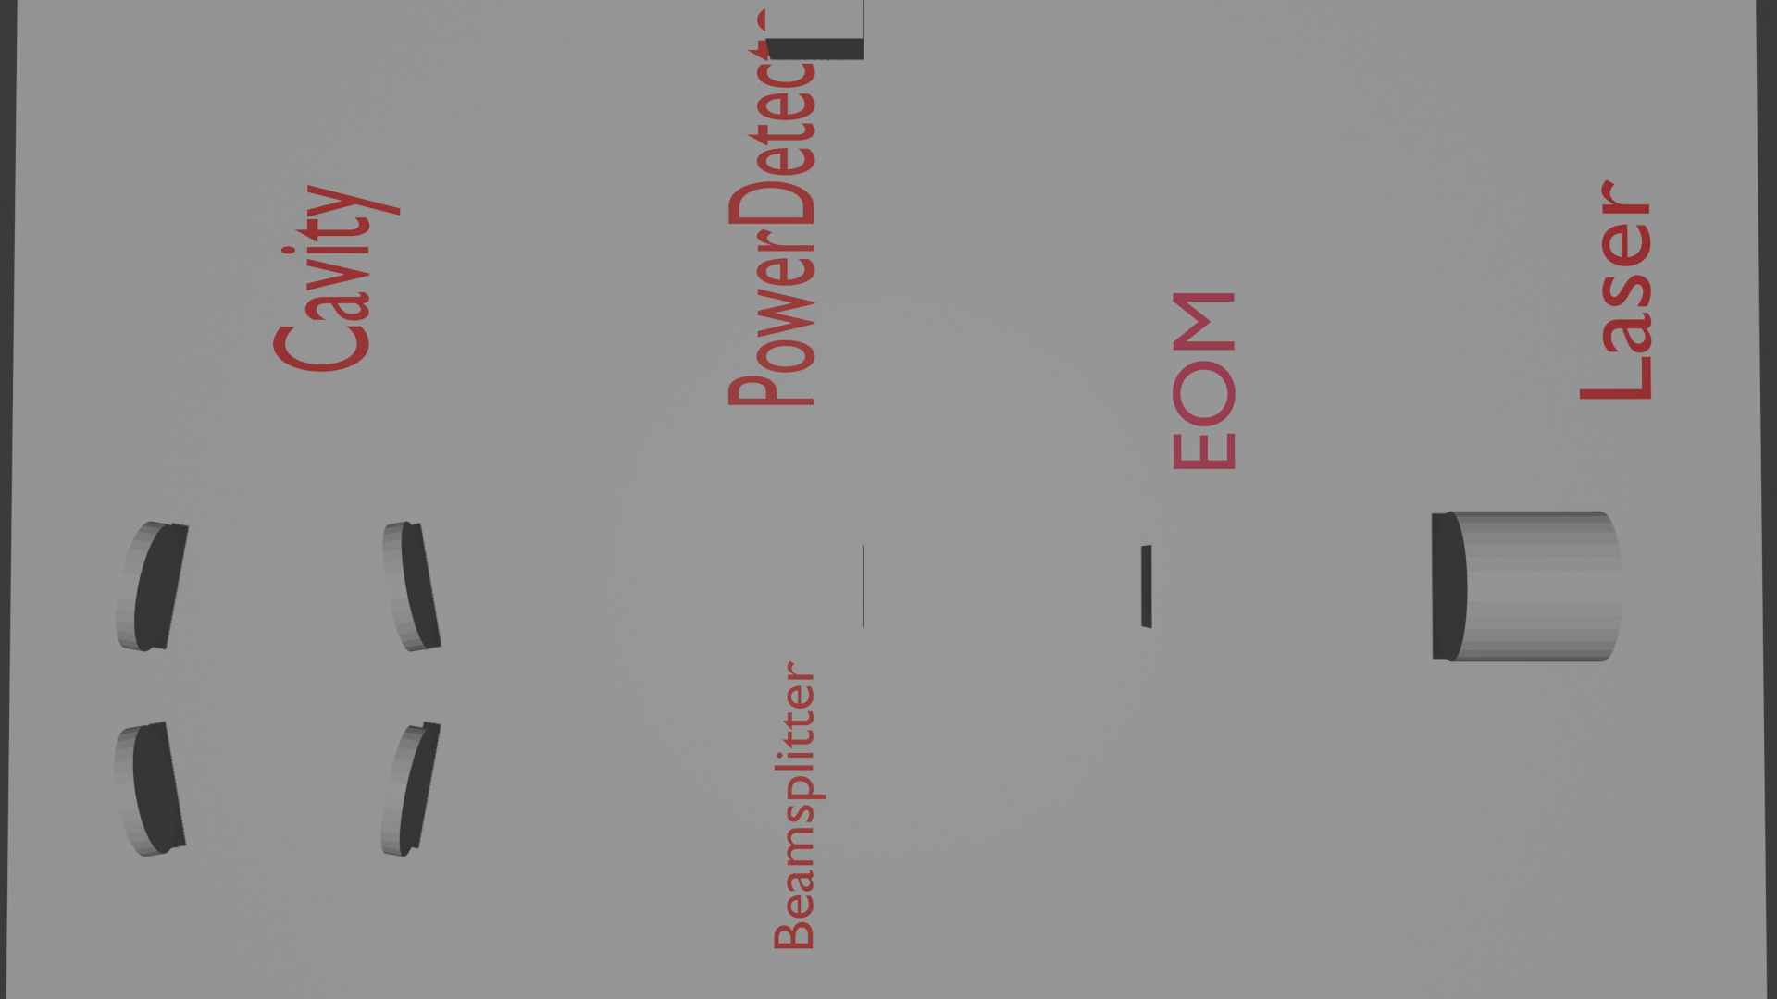

Seismic noise
$$V_{in}$$
Actuator
Mirror
Sensor
Amplifier
Notes:
Mention what a feedback loop
What happens if the mirrors are tilted?

Slide 11
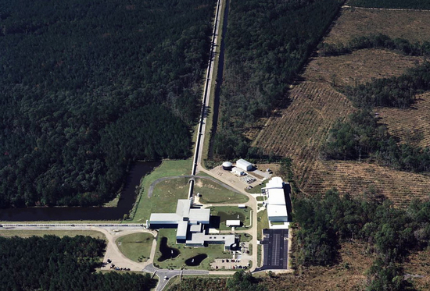
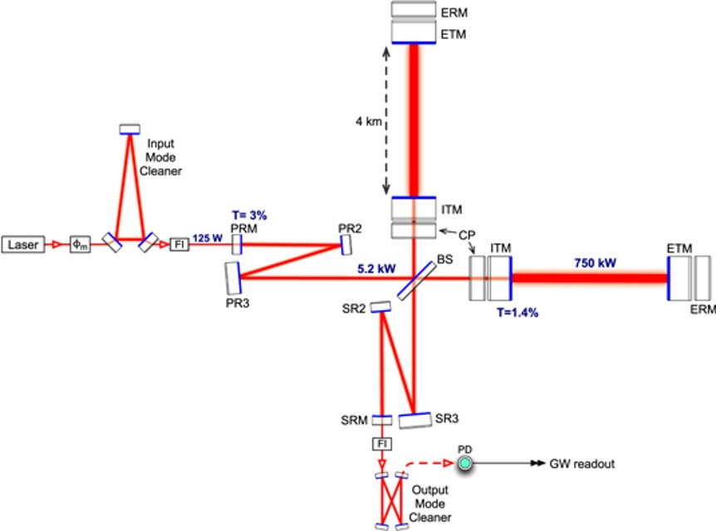
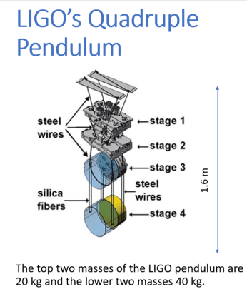
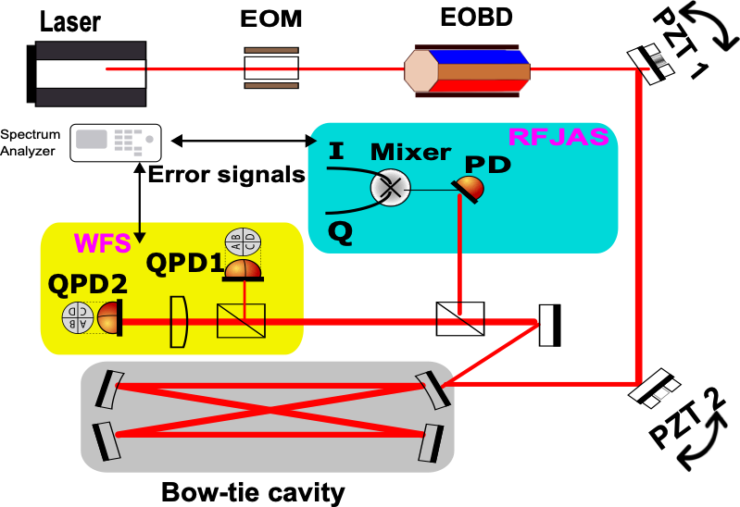
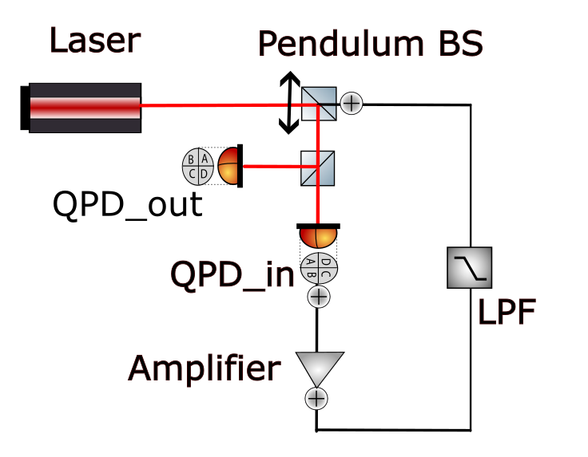
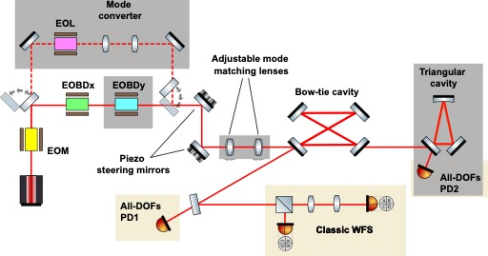
Outline
Intro to LIGO

Slide 12
Outline
LIGO optical layout

Slide 13
Outline
Noises in the detectors

Slide 14
Outline
Alignment Sensing & Control in LIGO

Slide 15
Outline
Two alignment schemes
Notes:
intoduce the two sensing schemes i mentioned in the title

Slide 16
Outline
My progress & results

Slide 17
Outline
Simulation Project

Slide 18
Outline
Future Plans

